Slide 1
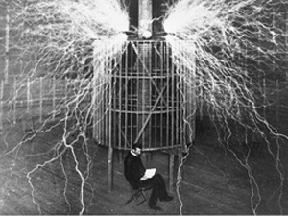
Section 13: Alternating Current
The Current Wars

Slide 2
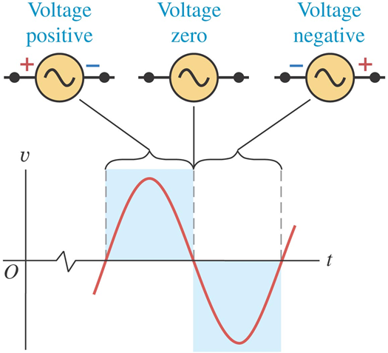

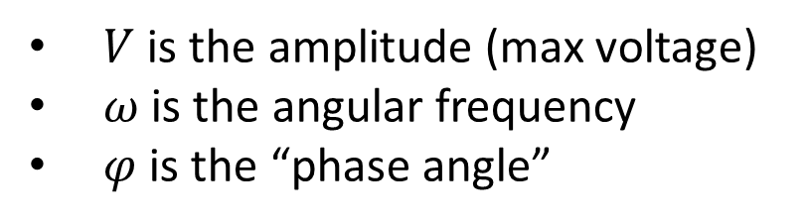
Alternating Voltage Source
$$v(t)=V\cos\left(ωt+φ\right)$$
$V$ is the amplitude (max voltage)
$ω$ is the angular frequency
$φ$ is the “phase angle”

Slide 3

Alternating Current
$$i\left(t\right)=I\cos{(ωt})$$
$I$ is the amplitude (max current)
$ω$ is the angular frequency

Slide 4
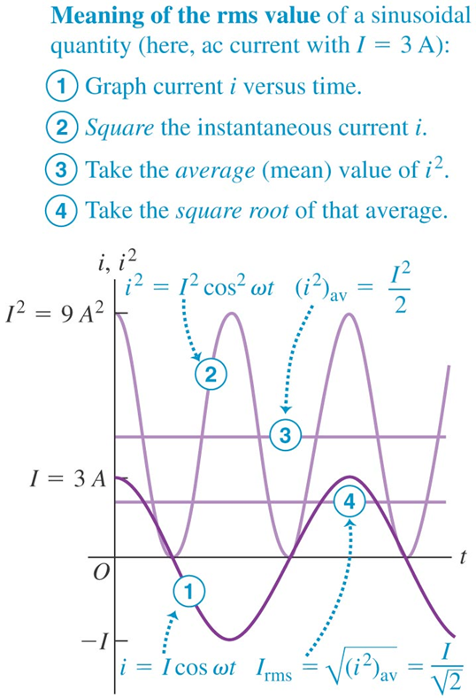
RMS Current and Voltage

Slide 5
Activity: Current and Voltage Functions

Slide 6
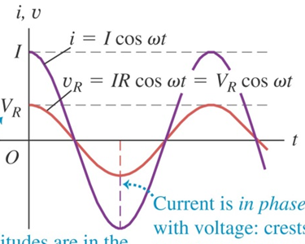
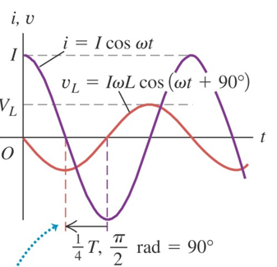
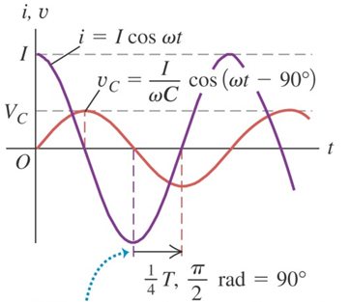

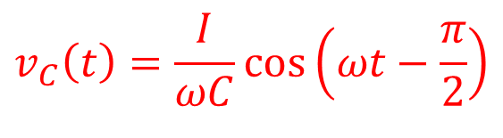
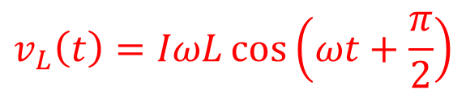
Voltages in the LRC Circuit
$$v_{R}\left(t\right)=IR\cos\left(ωt\right)$$
$$v_{L}\left(t\right)=IωL\cos\left(ωt+\frac{π}{2}\right)$$
$$v_{C}\left(t\right)=\frac{I}{ωC}\cos\left(ωt−\frac{π}{2}\right)$$

Slide 7
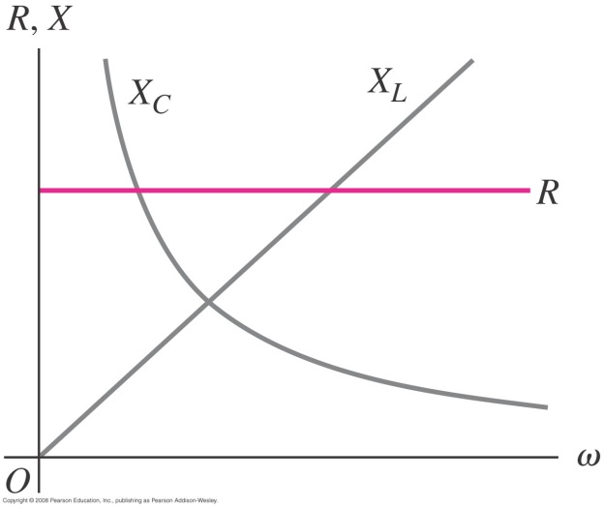

Reactance
$X_{R}=R$ $X_{L}=ωL$ $X_{C}=\frac{1}{ωC}$

Slide 8
Activity: Reactance

Slide 9
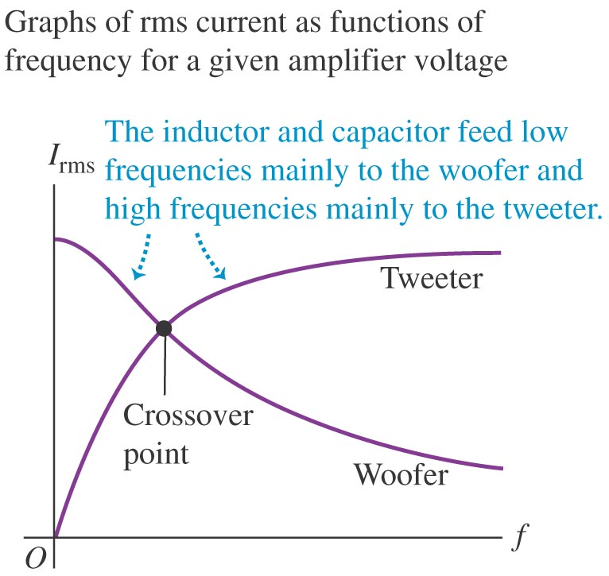
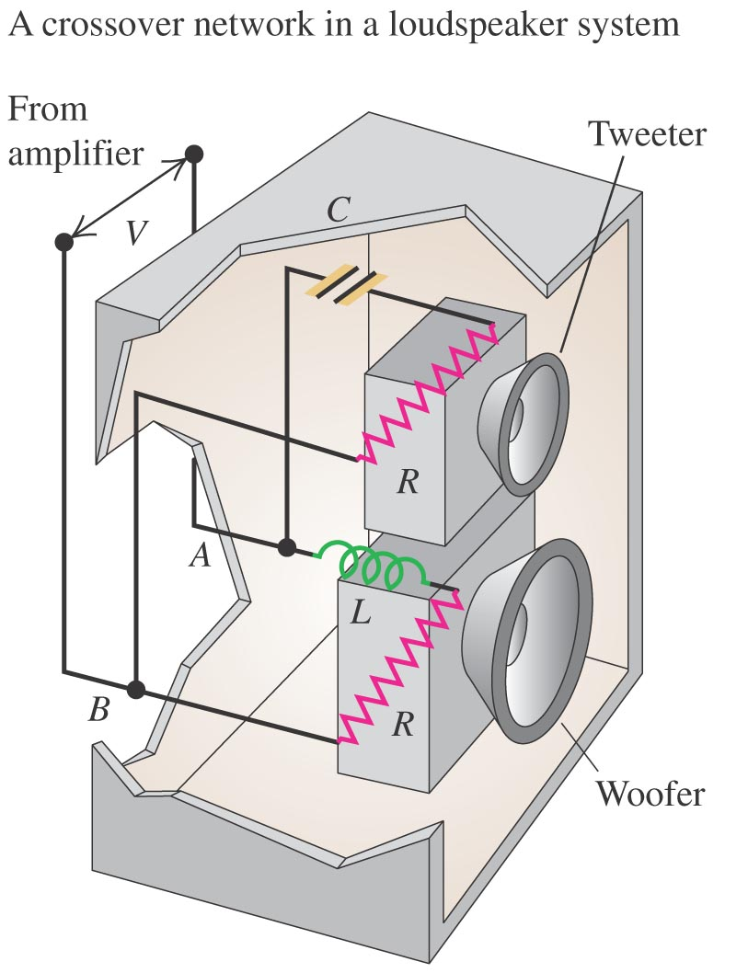
The loudspeaker, a useful application

Slide 10
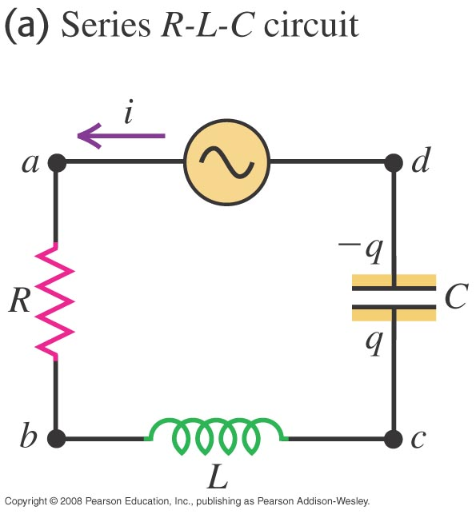
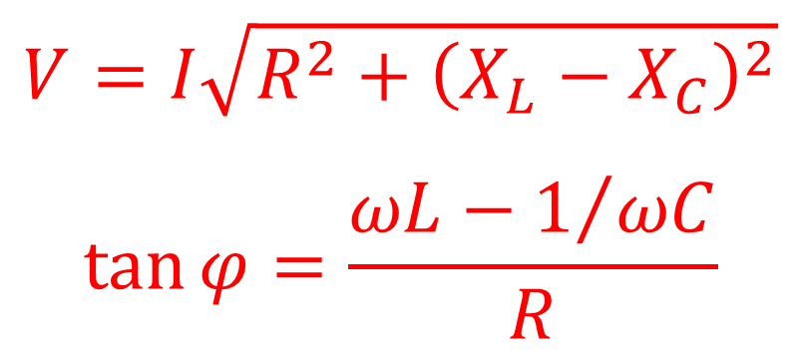
The L-R-C circuit: Everything together!
$$V=I\sqrt{R^{2}+{\left(X_{L}−X_{C}\right)}^{2}}$$
$$\tan{φ}=\frac{ωL−1/{ωC}}{R}$$

Slide 11
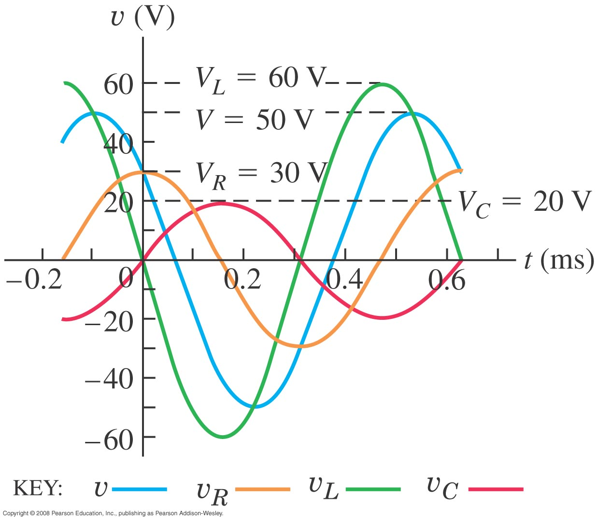
An L-R-C circuit: All voltages

Slide 12
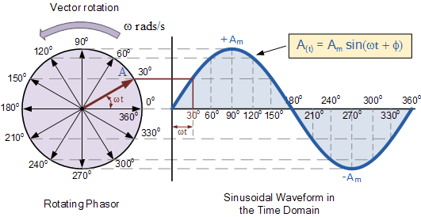
Phasors
A useful tool for analysis!

Slide 13
Activity: Phasors

Slide 14
Group Problem: Pre-Lab 8 Part I

Slide 15
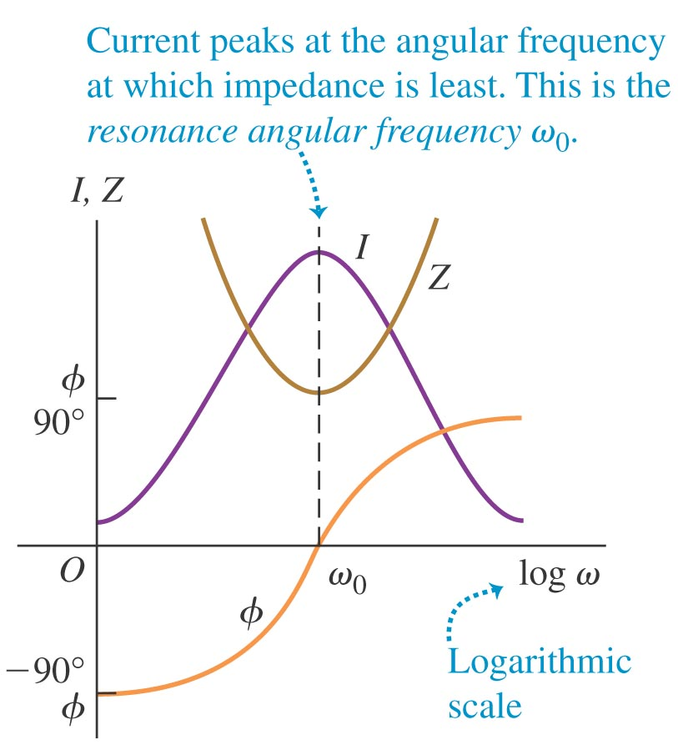
RESONANCE

Slide 16
Group Problem: Lab 8 Part II

Slide 17
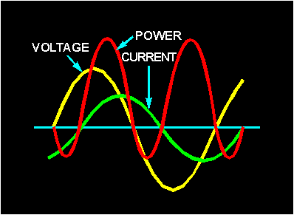

Power in Alternating Circuits
$$p_{source}=vi=\left[V\cos\left(ωt+φ\right)\right]\left[I\cos{ωt}\right]$$

Slide 18

Power in Alternating Circuits
$$P_{avg, source}=P_{avg, R}=\frac{1}{2}VI\cos{φ}$$
$\cos{φ}$ is called the “Power Factor”.

Slide 19
Example: Power in an AC Circuit

Slide 20
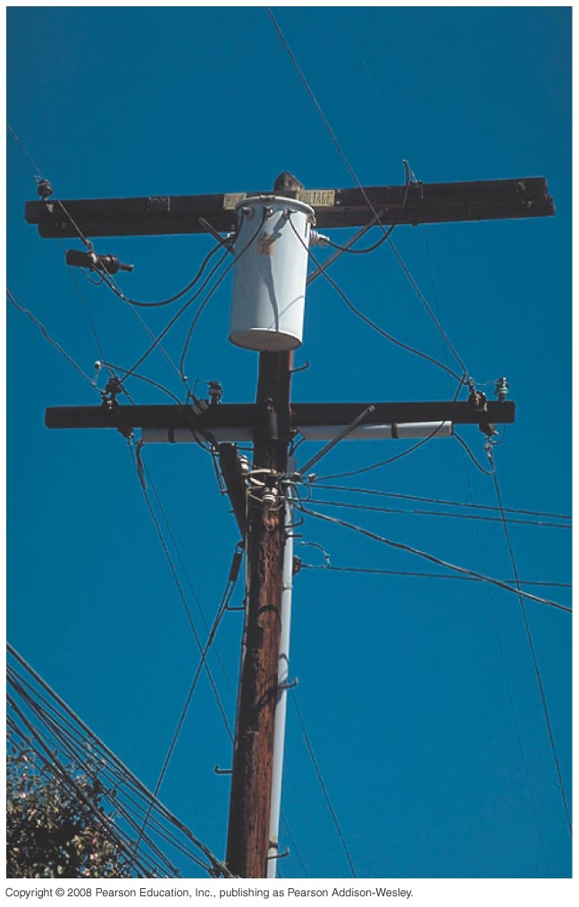
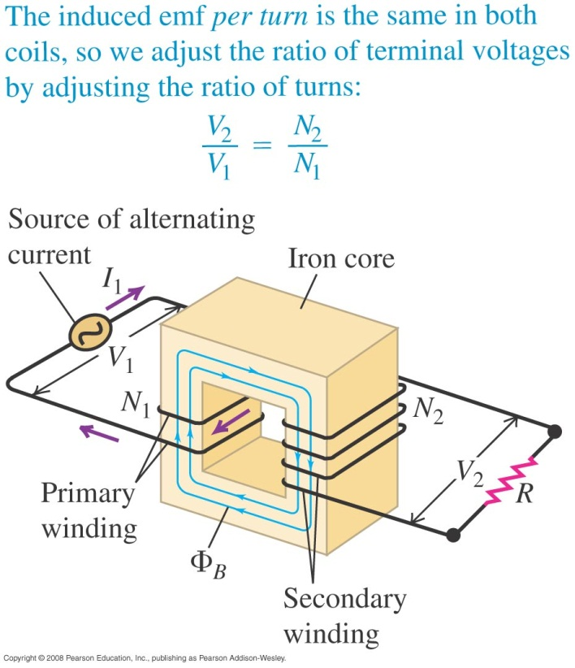
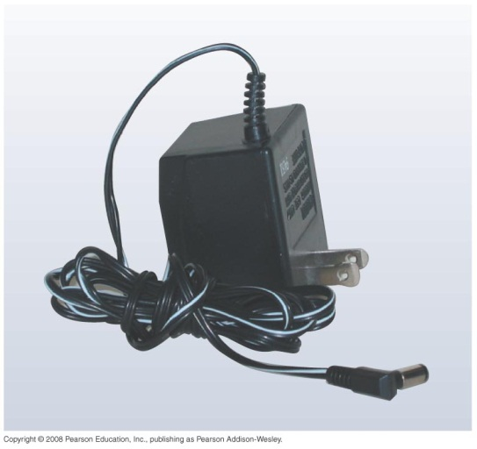
Transformers
We drive by them, carry them, and sit in front of them.

